Slide 1

Stock Analysis
Kyle Breda
Eduardo Calles
Anand Krishnan
Sarah Rupprecht

Slide 2





Slide 4
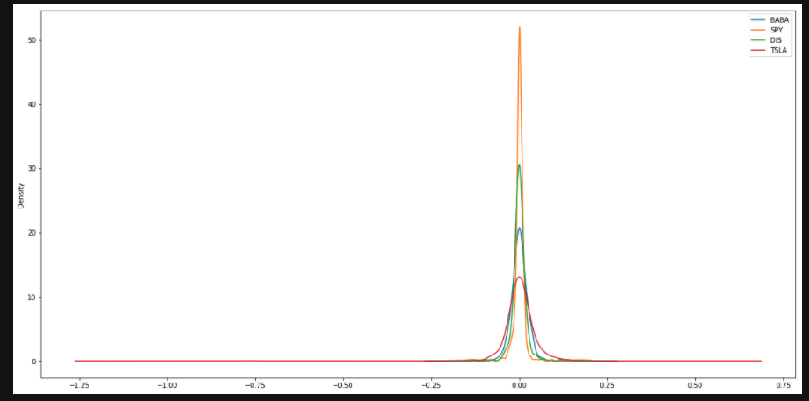

Slide 6
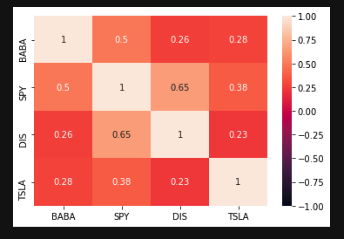

Slide 7
MC: Initial Investment of $10,000 over the next year
Stock | Min | Max
SPY | $4,758.51 | $69,339.08
BABA | $3,776.86 | $96,441.37
DIS | $7,703.55 | $51,250.86
TSLA | $1,214.95 | $75,128.56

Slide 8
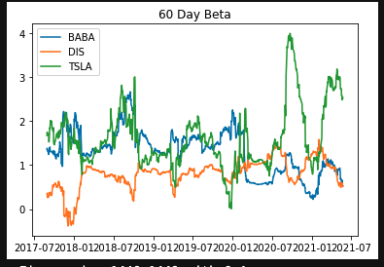

Slide 9
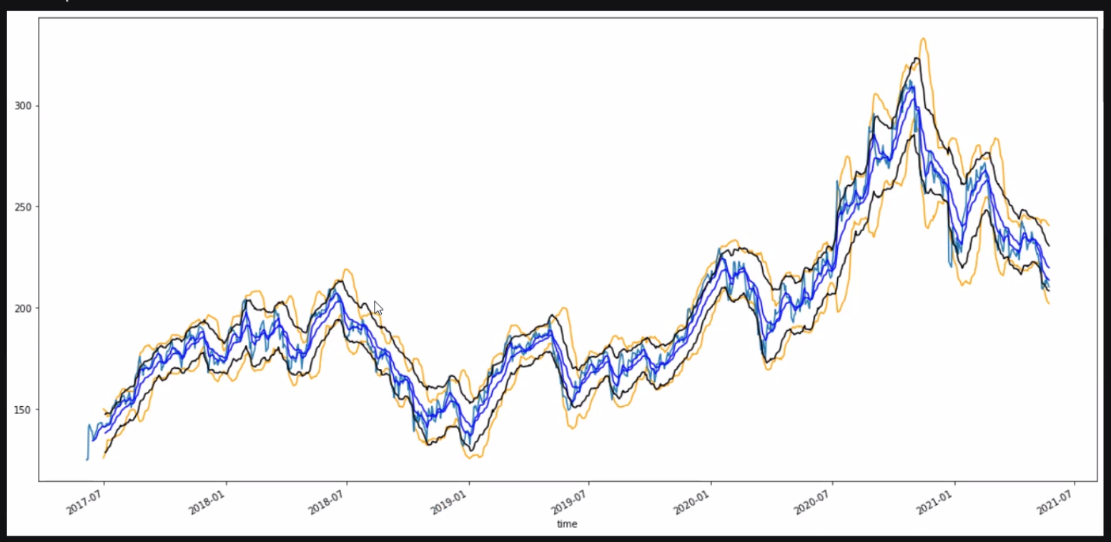

Slide 10
